Slide 1
Binary Logit/Probit
Murthi

Slide 2
Questions
A medical researcher is interested in predicting the probability of getting a heart attack knowing the blood pressure, cholesterol, calorie intake, gender and physical activity
Predict whether a household would subscribe to a package of premium channels
A credit card issuing bank would like to predict the probability that a customer will default

Slide 3
What other prediction problems can you think of in each area?
Insurance industry
Finance industry
Healthcare industry
Retail industry
Web analytics

Slide 4
When to use these methods?
In all the previous situations, notice that the dependent variable is discrete and binary.
If Y is continuous then regression is used.
If Y is binary and discrete, then logit/probit can be used.
If Y has more than 2 levels and is discrete, then use
Multinomial Logit (MNL) or
Multinomial Probit (MNP)
e.g., Which brand will a person choose (A, B, C, or D)
Which major will an MBA student choose?

Slide 5
Scatterplot of with Y=(0,1): Y = Hired-Not Hired; X= Experience
Y
1
0
X

Slide 6
The Linear Probability Model (LPM)
If we estimate the slope using OLS regression:
Hired = α + β*Exper + e ;
The result is called a “Linear Probability Model”
The predicted values are probabilities that Y equals 1;
The equation is linear – the slope is constant

Slide 7
Picture of LPM
Y
1
LPM Regression Line
(slope coefficient)
Points on regression line represent predicted probabilities
For Y for each value of X
0
X

Slide 8
LPM Weaknesses
The predicted probabilities can be greater than 1 or less than 0
The error terms vary based on size of X-variable (“heteroskedastic”) –
There may be models that have lower variance – more “efficient”
The errors are not normally distributed because Y takes on only two values

Slide 9
S-shape - Logistic Regression
Y
1
Logistic Regression
(non-linear slope coefficient)
Points on regression line represent predicted probabilities
For Y for each value of X
0
X

Slide 10
Suppose our underlying dummy dependent variable depends on an unobserved utility index, Y*
Y is discrete—taking on the values 0 or 1 if someone buys a car, for instance
Imagine a continuous variable Y* that reflects a person’s desire to buy the car
Y* would vary continuously with some explanatory variables like income, age

Slide 11
Utility can be written as:
Y_{i}* = a + bX_{1i}+ ε_{i}
If the utility index is “high enough,” a person will buy a car
Y_{i} = 1, if Y_{i}* > 0
If the utility index is not “high enough,” a person will not buy a car
Y_{i} = 0, if Y_{i}* <= 0

Slide 12
If cdf is Normal distribution, we get a probit model
If cdf is logistic distribution, then we get a logit model.

Slide 13
Estimation of the β’s typically done using a maximum likelihood estimator (MLE)
Each outcome Yi has the density function ƒ(Yi)
= P_{i}^{Yi} (1 − P_{i})^{1 − Yi}
Each Yi takes on either the value of 0 or 1 with
probability ƒ(0) = (1 − P_{i}) and ƒ(1) = P_{i}

Slide 14
Likelihood function

Slide 15
For the logit model we specify
Prob(Yi = 1) → 0 as β₀ + β₁X_{1i} → −∞
Prob(Yi = 1) → 1 as β₀ + β₁X_{1i} → ∞
Thus, probabilities from the logit model will be between 0 and 1

Slide 16
A complication arises in interpreting the estimated β’s
With a linear probability model, a β estimate measures the ceteris paribus effect of a change in the X variable on the probability Y equals 1
In the logit model

Slide 17
Probit Model
In the probit model, we assume the error in the utility index model is normally distributed
ε_{i} ~ N(0,σ²)
Where F is the standard normal cumulative
density function (c.d.f.)

Slide 18
Which is better – logit/probit?
From an empirical standpoint logits and probits typically yield similar estimates of the relevant derivatives
Because the cumulative distribution functions for the two models differ slightly only in the tails of their respective distributions
The derivatives are different only if there are enough observations in the tail of the distribution
While the derivatives are usually similar, the parameter estimates associated with the two models are not
Multiplying the logit estimates by 0.625 makes the logit estimates comparable to the probit estimates

Slide 19
Are stocks of larger firms favored?

Slide 20
Contingency Table
Type of Stock | Large | Small | Total
Preferred | 10 | 2 | 12
Not Preferred | 1 | 11 | 12
Total | 11 | 13 | 24

Slide 21
Basic Concepts
Probability
Probability of being ‘preferred’ stock = 12/24 = 0.5
Probability that a company’s stock is preferred given that the company is large = 10/11 = 0.909
Probability that a company’s stock is preferred given that the company is small = 2/13 = 0.154

Slide 22
Odds and Probability
Odds(Event) = Prob(Event)/(1-Prob(Event))
O = p/(1-p)
Prob(Event) = Odds(Event)/(1+Odds(Event))
p = O/(1+O)

Slide 23
Concepts … contd.
Odds
Odds of a preferred stock = 12/12 = 1
Odds of a preferred stock given that the company is large = 10/1 = 10
Odds of a preferred stock given that the company is small = 2/11 = 0.182

Slide 24
Logistic Regression
Take Natural Log of the odds:
ln(odds(Preferred|Large)) = ln(10) = 2.303
ln(odds(Preferred|Small)) = ln(0.182) = -1.704
Combining these relationships
ln(odds(Preferred|Size)) = -1.704 + 4.007*Size
Log of the odds (or logit) is a linear function of size
The coefficient of size can be interpreted like the coefficient in regression analysis
i.e., For 1 unit increase in Size, change in log-odds=4.007
But what does it mean in plain english?

Slide 25
General Model
ln(odds) = β₀ + β₁X₁ + β₂X₂ +…+ β_{k}X_{K} (1)
Recall:
Odds = p/(1-p)
ln(p/1-p) = β₀ + β₁X₁ + β₂X₂ +…+ β_{k}X_{K} (2)
p =
OR
p =

Slide 26
Interpretation
If size=10, log-odds (LO)= -1.704 + 4.007*10
If size=11, log-odds (LO)= -1.704 + 4.007*11
Difference(LO₁₁-LO₁₀)=4.007
Take exp on both sides:
Exp((LO₁₁-LO₁₀))=exp(4.007)
Odds₁₁/Odds₁₀ = exp(4.007)
For a unit change in size, Odds will increase by a multiple of 55 times.
Odds₁₁ = exp(4.007)*Odds₁₀
Odds₁₁ ₋ Odds₁₀ = (exp(4.007)-1)Odds₁₀
Percentage change in odds for a unit change in size =
(exp(4.007)-1)*100

Slide 27
Interpretation of discrete variable coefficients
If X is gender (M=1, F=0)
Odds_{M}/Odds_{F} =exp(β)
Percentage increase in Odds_{M} = (exp(β)-1)*100

Slide 28
Likelihood
This is the joint probability of observing the 1s and 0s in the sample of data.
For one observation y=1, lik = p₁
For two observations y={1,0}, lik=p₁p₀
If y={1011001}, lik=p₁p₀p₁p₁p₀p₀p₁ = p₁⁴ p₀³
Log-lik=log(p₁⁴ p₀³) = 4*log(p₁)+3*log(p₀)
If there are 50 purchases among a sample of 300, loglik=50*log(50/300)+250*log(250/300)= -135.17
Maximum value of log-lik = 0.

Slide 29
Interpretation of Results - Model Fit
Look at the –2 Log L statistic
Null Model: Intercept only model (i.e. no X variables): 33.271
Intercept and Covariates: 17.864
Difference: 15.407 with 1 DF (p=0.0001)
Means that the size variable is explaining a lot
McFadden’s R-sq = diff. in (-2LogL)/Null model’s (-2logL)
= 15.4/33.27 =46%

Slide 30
Do the Variables Have a Significant Impact?
Like testing whether the coefficients in the regression model are different from zero
Look at the output from Analysis of Maximum Likelihood Estimates
Loosely, the column Pr>Chi-Square gives you the probability of realizing the estimate in the Parameter estimate column if the estimate were truly zero – if this value is < 0.05 the estimate is considered to be significant

Slide 31
Model fit
Akaike’s Information Criterion (AIC), Schwartz’s Criterion (SC or BIC)
like Adj-R² applies a penalty
there is a penalty for having additional covariates
AIC = [-2logL + 2p]
SC (or BIC) = [-2logL + plog(n)]
BIC penalizes more heavily
Model with lower AIC/BIC is better.

Slide 32
Predicted Probabilities and Observed Responses
The response variable (success) classifies an observation into an event or a no-event
A concordant pair is defined as that pair formed by an event with a PHAT higher than that of the no-event
Higher the concordance %, the better the model
Hit ratio = % events correctly classified

Slide 33
Classification
For a set of new observations where you have information on size alone
You can use the model to predict the probability that success = 1 i.e. the stock is favored
If PHAT > 0.5 success = 1 else success=0

Slide 34
Logistic model
Own price elasticity = (1-prob(j))*X_{j}*β
Cross price elasticity = (-prob(j))*X_{j}*β

Slide 35
Model fit indicators
AIC - Akaike Information Criterion.
AIC = -2 Log L + 2((k-1) + s),
where k is the number of levels of the dependent variable and s is the number of predictors in the model. The model with the smallest AIC is considered the best.
SC - Schwarz Criterion.
SC = - 2 Log L + ((k-1) + s)*log(Σ f_{i}),
where f_{i}'s are the frequency values of the i^{th} observation, and k and s were defined previously. Smallest SC is most desirable.
-2 Log L - is used in hypothesis tests for nested models.

Slide 36


McFadden’s R²
M_{full} = Model with predictors
M_{intercept} = Model without predictors

Slide 37
https://stats.idre.ucla.edu/sas/output/proc-logistic/

Slide 38
Direct Marketing
A company wants to do a mail marketing campaign.
costs = $1 for each item mailed.
They have information on 100,000 customers.
Overall response rate = 20%
If all 100,000 customers are contacted then we will get 20,000 responses.

Slide 39
Develop a logit model to predict response.
Sort the customers based on probability of response and divide them into deciles.

Slide 40
Data to plot lift chart and Cumulative Gains chart
Cost | Contacts | Positive responses with model | Positive responses No model | lift | Cumulative gains chart = positive responses/total responses
10000 | 10000 | 6000 | 2000 | 3 | 6000/20000=30%
20000 | 20000 | 10000 | 4000 | 2.5 | 10000/20000 = 50%
30000 | 30000 | 13000 | 6000 | 2.166 | 13000/20000 = 65%
40000 | 40000 | 15800 | 8000 | 1.975 | 79%
50000 | 50000 | 17000 | 10000 | 1.70 | 85%
60000 | 60000 | 18000 | 12000 | 1.50 | 90%
70000 | 70000 | 18800 | 14000 | 1.343 | 94%
80000 | 80000 | 19400 | 16000 | 1.212 | 97%
90000 | 90000 | 19800 | 18000 | 1.10 | 99%
100000 | 100000 | 20000 | 20000 | 1.00 | 100%

Slide 41
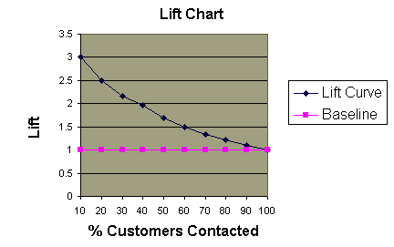

Slide 42
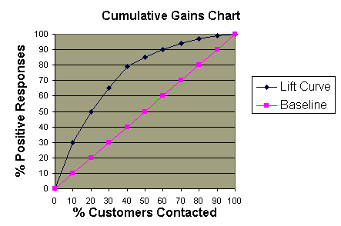

Slide 43
Predicted | Actual | Label
0 | 0 | True Negative (TN)
0 | 1 | False Negative (FN)
1 | 0 | False Positive (FP)
1 | 1 | True Positive (TP)

Slide 44
 | Predicted = 1 | Predicted =0
Actual=1 | 10 | 2
Actual=0 | 3 | 35
TP+FN=P (number of actual 1s)
TN+FP=N (number of actual 0s)
FP rate=FP/N = fall-out = % neg. mis-classified
TP rate = TP/P = Recall or hit rate = % pos. correctly classified
Precision = TP/(TP+FP)
Accuracy = (TP+TN)/(P+N)

Slide 45
Percent concordance
Pick a random 1 and a random 0
Is the model predicted Prob(1)> Prob(0)? = concordance
Ot
Otherwise it is discordant.
The AUC is the probability that the classifier will rank a random positive example higher than a randomly chosen negative example.
(P(score(x+) > score(x-))

Slide 46
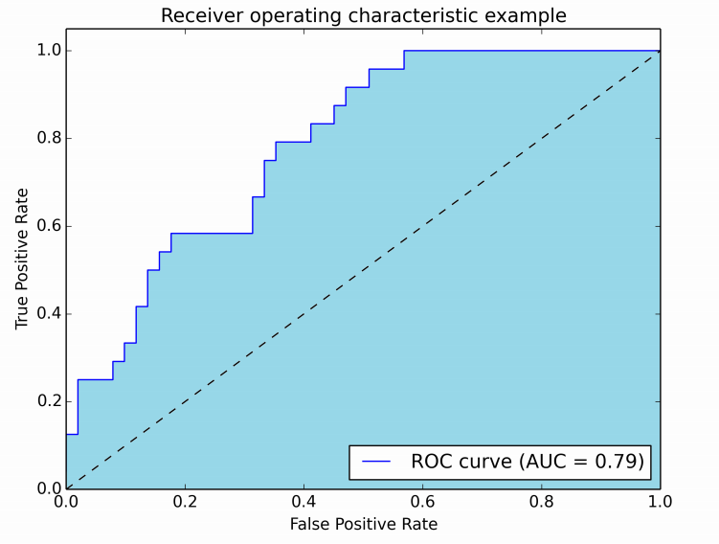
AUC: Receiver Operating Characteristic (ROC curve)
Plot TPR against FPR to get ROC curve
Dotted line indicates ROC curve of a random predictor.
ROC >0.5 or ROC<0.5 is good.
ROC=1 and ROC =0 are the best.
Use ROCR package in R

Slide 47
SAS code
data Data1;
input disease n age;
datalines;
0 14 25
0 20 35
0 19 45
7 18 55
6 12 65
17 17 75 ;
ods graphics on;
proc logistic data=Data1 plots(only)=(roc(id=obs) effect);
model disease/n=age / scale=none clparm=wald clodds=pl rsquare;
units age=10;
run;
ods graphics off;

Slide 48
data roc;
input alb tp totscore popind @@;
totscore = 10 - totscore;
datalines;
3.0 5.8 10 0 3.2 6.3 5 1 3.9 6.8 3 1 2.8 4.8 6 0
3.2 5.8 3 1 0.9 4.0 5 0 2.5 5.7 8 0 1.6 5.6 5 1
3.8 5.7 5 1 3.7 6.7 6 1 3.2 5.4 4 1 3.8 6.6 6 1
4.1 6.6 5 1 3.6 5.7 5 1 4.3 7.0 4 1 3.6 6.7 4 0
2.3 4.4 6 1 4.2 7.6 4 0 4.0 6.6 6 0 3.5 5.8 6 1
3.8 6.8 7 1 3.0 4.7 8 0 4.5 7.4 5 1 3.7 7.4 5 1
3.1 6.6 6 1 4.1 8.2 6 1 4.3 7.0 5 1 4.3 6.5 4 1
3.2 5.1 5 1 2.6 4.7 6 1 3.3 6.8 6 0 1.7 4.0 7 0
3.7 6.1 5 1 3.3 6.3 7 1 4.2 7.7 6 1 3.5 6.2 5 1
2.9 5.7 9 0 2.1 4.8 7 1 2.8 6.2 8 0 4.0 7.0 7 1
3.3 5.7 6 1 3.7 6.9 5 1 3.6 6.6 5 1
;
ods graphics on;
proc logistic data=roc plots=roc(id=prob);
model popind(event='0') = alb tp totscore / nofit;
roc 'Albumin' alb;
roc 'K-G Score' totscore;
roc 'Total Protein' tp;
roccontrast reference('K-G Score') / estimate e;
run;
ods graphics off;
NOFIT option to prevent PROC LOGISTIC from fitting the model with three covariates.
The ROCCONTRAST statement implements the nonparameteric approach of DeLong, DeLong, and Clarke-Pearson (1988) to compare the three ROC curves.
REFERENCE option specifies that the K-G Score curve is used as the reference curve in the contrast
The E option displays the contrast coefficients, and the ESTIMATE option computes and tests each comparison

Slide 49
Rare events
In a binary variable (response/no-response, good/bad, default/no-default, purchase/no-purchase, etc.) one of the two events is rare.
In a sample of 1000 applicants, only 20 are selected – low event rate of 2%▪
In a sample of 100,000 purchases from an online retailer, about 1800 are returned by the customer – low event rate of 1.8%
Some real life examples:
▪ Percentage of defaulters in credit card transactions
▪ Goods returned in online retailing
Why is this a problem for logistic regression?
The usual maximum-likelihood estimation method is susceptible to ‘small sample bias’ and this bias is strongly dependent on the count (as opposed to percentage) of the rarer of the events.

Slide 50
Exact logistic regression
Solutions
Exact logistic regression
Computationally intensive.
Good for small samples or unbalanced data with few covariates (<200)
Proc logistic data = a1 descending;
Freq cellcount; /* cellcount is the weight variable here */
Model y=x1 x2;
Exact x1/estimate=both;
run;

Slide 51
Alternative code:
Proc logistic data = a1 descending;
Model y/cellcount =x1 x2;
Exact x1/estimate=both;
run;

Slide 52
Penalized likelihood (Firth’s method)
If you have a larger count of the rare events say 1000 in a sample of 100,000 you can use logistic regression using the penalized likelihood approach (Firth).
Proc logistic data = a1;
Class catvar1 catvar2/param=ref;
Model y = catvar1 catvar2 x1 x2/firth;
run;

Slide 53
Oversampling
Create a sample with many examples of rare events (say 500). Match it with a sample of non-occurrence of the event cases in approximately 50-50% ratio or even 33-66% ratio.
Then estimate the logit model.

